Slide 1

Hands on Introduction to Spark
Power of data. Simplicity of design. Speed of innovation.
Joel Patterson
Bernie Beekman
Davin Shearer
Notes:
Welcome to ….
Be sure to document on the whitebioard the urls
for DSWB
for lab Notebooks ibm.box.xom/IntroApacheSpark Passsword = IBMSpark
for the POT Survey
Note the survey will revela the instructor notebooks upon completion.
IBM Big Data & Analytics © 2016 IBM Corporation

Slide 2

Agenda
9:00 - 10:00 - Kick off
Introduction to Spark
Introduction to the Data Science Experience
Register for Platform – datascience.ibm.com
10:00 - 11:30 - Lab 1 – Introduction to Spark
Overview of Lab
Hands on Exercises
11:30 – 1:45 Lab 2 – Spark SQL
Overview of Lab
Lunch/Hands on Exercises
1:45 - 2:00 – Break
2:00 - 3:45 - Lab 3 – Spark Machine Learning
Overview of Lab
Hands on Exercises
3:45 - 4:00 – Break
4:00 - 4:30 – Questions/Wrap Up
© 2016 IBM Corporation

Slide 3

What is Spark?
Spark is an open source
in-memory
application framework for
distributed data processing and
iterative analysis
on massive data volumes
“Analytic Operating System”
Notes:
Spark isn't a data store as it has to connect to other relational, non relational data stores, as well as handling data at rest and data on the fly (streams of data Other than the doesn't’t have its own.
Spark isn't only for Spark is a separate stand-alone system or service
Spark isn't only for Hadoop as it can be used without Hadoop as well, and to process and analyze data sources in other data sources like DashDB, any relationship database, Cloudant, Cassandra and Amazon S3.
Spark isn't only for machine learning – Spark includes machine learning and does it very well, but it can handle much broader tasks equally well
Spark isn't a replacement for Streams – Spark Streaming is micro-batching, not true streaming, and cannot handle the real-time complex event processing that true streams do in version 1.6
IBM’s objective is that we offer our customers the power of Spark in whichever way they want to leverage it. So Spark and Hadoop coexist in our portfolio, and IBM is committed to advancing Hadoop and using Spark to enhance the value of the information inside of Hadoop. For existing BigInsights customers or Hadoop adopter customers, it’s not an either-or situation; Spark can be used to analyze information in Hadoop, exploiting the investments made to put data there. For existing BigInsights customers or Hadoop adopter customers, it’s not an either-or situation; Spark can be used to analyze information in Hadoop, exploiting the investments made to put data there.
True multi purpose MPP (Massively Parallel Platform)
IBM Big Data & Analytics © 2016 IBM Corporation

Slide 4
Why Spark?
Performant
In-memory architecture greatly reduces disk I/O
Improved performance compared to MapReduce
Productive
Concise and expressive syntax, especially compared to prior approaches
Single programming model across a range of use cases and steps in data lifecycle
Integrated with common programming languages – Java, Python, Scala, R
New tools continually reduce skill barrier for access (e.g. SQL for analysts)
Leverages existing investments
Works well within existing Hadoop ecosystem
Improves with age
Large and growing community of contributors continuously improve full analytics stack and extend capabilities
Notes:
Note that this is a marketing slide. We can correct some of the perception it gives.
Performance:
The 20-100x faster is not qualified: faster than what?
It turns out that this information comes from the home page of the Apache Spark site. It is compared to Hadoop MapReduce.
We should not set this type of expectation since this is one very specific benchmark that is highly iterative.
We don’t need to sell Spark. What is important is to demonstrate our commitment to Spark. It would be much better to
Tell customers that they should see performance improvements compared to MapReduce but never support those multipliers.
Productivity:
One of the reason for increased productivity is the fact that Spark comes with a set of classes and methods that
allow a programmer to get to the desired result faster. MapReduce did not have those pre-built capabilities.
Note that having pre-built capabilities does not remove the learning curve to become competent with the product.
Finally, mentioning “SQL” as part of new tools speaks to the state of open-source projects: they are mainly for technologists (programmers). A lot more needs to be done to make it easy to use.
Leverage existing investment: You can still use your Hadoop (BigInsights) environment.
Improves with age:
Spark is the largest and most active Apache project. As we’ll see later, the product has evolved quickly and will
certainly continue to do so for quite a while.
IBM Analytics
© 2015 IBM Corporation

Slide 5

Apache Spark Scales
Spark Application
(Driver Program)
Spark programs generally consist of two components: driver program and worker program(s)
  Driver Program manages the division of computations (Task) that are sent to worker nodes
  Worker programs run smaller portions of computations
The SparkContext object instructs Spark on how & where to access a cluster
Cluster Manager manages the physical resources needed to run driver and worker programs.
SparkContext
Cluster Manager
Local Threads
Worker Node
Worker Node
Spark Executor
Spark Executor
Cache
Cache
Swift (SoftLayer), AWS S3, HDFS, or other storage
Notes:
Spark applications run as independent sets of processes on a cluster, coordinated by the SparkContext object in your main program (called the driver program).
Each application gets its own executor processes, which stay up for the duration of the whole application and run tasks in multiple threads. This has the benefit of isolating applications from each other, on both the scheduling side (each driver schedules its own tasks) and executor side (tasks from different applications run in different JVMs). However, it also means that data cannot be shared across different Spark applications (instances of SparkContext) without writing it to an external storage system.
Spark is agnostic to the underlying cluster manager. As long as it can acquire executor processes, and these communicate with each other, it is relatively easy to run it even on a cluster manager that also supports other applications (e.g. Mesos/YARN).
The driver program must listen for and accept incoming connections from its executors throughout its lifetime (e.g., see spark.driver.port in the network config section). As such, the driver program must be network addressable from the worker nodes.
Because the driver schedules tasks on the cluster, it should be run close to the worker nodes, preferably on the same local area network. If you’d like to send requests to the cluster remotely, it’s better to open an RPC to the driver and have it submit operations from nearby than to run a driver far away from the worker nodes.
Spark has 2 main parts, Driver and Worker programs.
The Driver Program manages the division of computations (or Task) that are sent to worker nodes
The Worker nodes run the task or smaller portions of computations
The SparkContext which is part of driver interacts with programing layer and instructs Spark on how to access the cluster
The Cluster Manager manages the physical resources needed to run driver and worker programs.

Slide 6
















Spark blends multiple data types, sources, and workloads
executes SQL statements
performs streaming analytics using micro-batches
common machine learning and statistical algorithms
distributed graph processing framework
Spark SQL
Spark Streaming
MLlib (machine learning)
GraphX (graph)
general compute engine, handles distributed task dispatching, scheduling and basic I/O functions
Spark Core Engine
large variety of data sources and formats can be supported, both on premise or cloud
BigInsights (HDFS)
Cloudant
dashDB
SQL DB
Object Storage
…many others
IBM CLOUD
OTHER CLOUD
CLOUD APPS
ON-PREMISE
Notes:
Where and how things fit together Note we are focused today on Spark SQL and MLlib stay tuned for more (hence the bolding for today)
Spark – has a core engine and set of libraries which consist of these 5 libraries
Where data comes from almost many different data sources ranging from relational, swift storage file system,,,
Spark – complements Hadoop – Collaboration
IBM Big Data & Analytics © 2016 IBM Corporation

Slide 7
Spark Programming Languages
Scala
  Functional programming
  Spark written in Scala
  Scala compiles into Java byte code
Java
  New features in Java 8 makes for more
  compact coding (lambda expressions)
Python
  Most widely used API with Spark today
R
  Functional programming language used for statistical computing
Language | 2014 | 2015
Scala | 84% | 71%
Java | 38% | 31%
Python | 38% | 58%
R | unknown | 18%
Survey done by Databricks,
Summer 2015
This probably means that more “data scientists” are starting to use Spark
DataFrames make all languages equally performant
Notes:
From Matei Zaharia presentation at IBM on Nov 2, 2015.
The Databricks survey also shows that the programming languages usage is changing. This is not to say that Scala is becoming less popular. It is likely because the type of people adopting Spark are coming more and more from a data science background which favors the use of Python and R.
A word of caution: Spark is written in Scala which is a language that compiles into Java byte code. This means that any functionality added to Spark Are automatically available in Scala (and likely Java). This is not the same for Python and R. On the bright side, the functionality gap between the languages is shrinking. We may get to a point where the differences wont matter.
IBM Big Data & Analytics © 2016 IBM Corporation

Slide 8


Benefits of Spark for Data Science
Spark SQL
Spark Streaming
MLlib
Machine Learning
GraphX Graphing
General compute engine
Basic I/O functions
Task dispatching
Scheduling
+
Spark Core
Spark is Easy…
→ Support multiple programing interfaces (Scala, Python, Java and R)
→ Less lines of code to get answers.
Spark is Agile…
→ Unified APIs (SQL, DataFrames, Streaming, Machine Learning, etc.)
→ Supports Notebooks (Jupyter, Zeppelin, Etc.)
Spark is Fast…
→ In-Memory processing that scales in a distributed architecture.
→ Application follows lazy evaluations architecture w/ optimized execution.

Slide 9
IBM is all-in on Spark
"It's like Spark just got blessed by the enterprise rabbi."
Contribute to the Core
Launch Spark Technology Center (STC), 300 engineers
Open source SystemML
Partner with Databricks
Ben Horowitz,
Andreessen Horowitz
Foster Community
Infuse the Portfolio
Integrate Spark throughout portfolio
3,500 employees working on Spark-related topics
Spark however customers want it – standalone, platform or products
Educate 1M+ data scientists and engineers via online courses
Sponsor AMPLab, creators and evangelists of Spark
Notes:
AMPLab – (algorithms, Machines, People) at University of California, Berkeley
IBM Distribution is called IODPi
Spark as a service on bluemix
IBM Big Data & Analytics © 2016 IBM Corporation

Slide 10
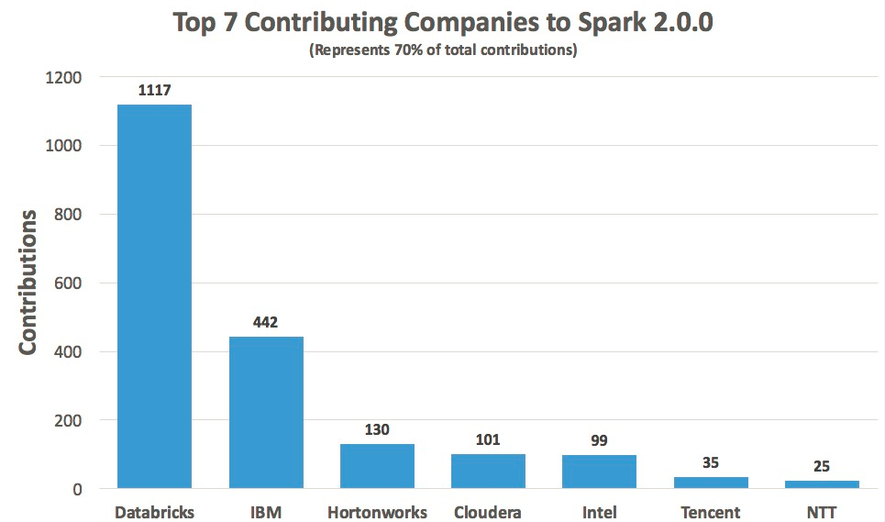

Slide 11
Apache Spark Under the hood!
Notes:
IBM Big Data & Analytics © 2016 IBM Corporation

Slide 12
Spark Terminology
Spark Context (Connection):
  Represents a connection to the Spark cluster. The Application which initiated the context can submit one or several jobs, sequentially or in parallel, batch or interactively.
Driver (Coordinator agent)
  The program or process running the Spark context. Responsible for running jobs over the cluster and converting the App into a set of tasks
Job (Query / Query plan):
  A piece of logic (code) which will take some input from HDFS (or the local filesystem), perform some computations (transformations and actions) and write some output back.
Stage (Subplan)
  Jobs are divided into stages
Tasks (Sub section)
  Each stage is made up of tasks. One task per partition. One task is executed on one partition (of data) by one executor
Executor (Sub agent)
  The process responsible for executing a task on a worker node

Slide 13

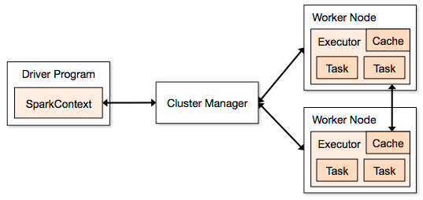
Spark Application Architecture
A Spark application is initiated from a driver program
Spark execution modes:
  Standalone with the built-in cluster manager
  Use Mesos as the cluster manager
  Use YARN as the cluster manager
  On-premise or any cloud (IBM BlueMix, Amazon, Azure, …)
Notes:
Leverage Jacques slides 10-14 for this section
The key to spark processing is still to have a distributed file system so all the file operations, including I/O can be done in parallel.
A Spark application is initiated by a driver program that eventually uses executors to execute tasks that represent the processing of a directed graph. More on directed graphs in a few slides.
RDD / Data Frame (abstraction of an RDD). RDD spread across all nodes (Spark – query optimizer for a map and reduce job creates a query plan which is broken into 1 or more tasks. Just like a DBMS cost base optimizer. For Example – word count , returned and summed. More complicated shuffling data. Deck of cards shuffled and spread across multiple nodes and count each node, and then do a summary across nodes (Massively Parallel Problem) . Ordered list by suit – may require shuffling data to organize it by suit or provide a proper order. Cluster manager does summarization
Terminology
▪Context (Connection):
Represents a connection to the Spark cluster. The Application which initiated the context can submit one or several jobs, sequentially or in parallel, batch or interactively.
▪Driver (Coordinator agent)
The program or process running the Spark context. Responsible for running jobs
over the cluster and converting the App into a set of tasks
▪Job (Query / Query plan):
A piece of logic (code) which will take some input from HDFS (or the local
filesystem), perform some computations (transformations and actions) and write some output back.
▪Stage (Sub plan)
Jobs are divided into stages
▪Tasks (Sub section)
Each stage is made up of tasks. One task per partition. One task is executed on
one partition (of data) by one executor
▪Executor (Sub agent)
The process responsible for executing a task on a worker node
Spsrk talks thru spss analystics server to get to the cluster manager
2 collaborators uploaded
Most recently uploaded February 21, 2016 at 6:10 PM by BRUCE FISCHER

Slide 14
Showing multiple applications
Each Spark application runs as a set of processes coordinated by the Spark context object (driver program)
  Spark context connects to Cluster Manager (standalone, Mesos/Yarn)
  Spark context acquires executors (JVM instance)
  on worker nodes
  Spark context sends tasks to the executors
Worker Node
Executor
Cache
Task
Task
Driver Program
Cluster Manager
App
SparkContext
Worker Node
Executor
Cache
Task
Task

Slide 15
Resilient Distributed Datasets
An RDD is a distributed collection of Scala/Python/Java/R objects of the same type:
  RDD of strings
  RDD of integers
  RDD of (key, value) pairs
  RDD of class Java/Python/Scala/R objects
An RDD is physically distributed across the cluster, but manipulated as one logical entity:
  Spark will “distribute” any required processing to all partitions where the RDD exists and perform necessary redistributions and aggregations as well.
  Example: Consider a distributed RDD “Names” made of names
Partition 1
Partition 2
Partition 3
Names
Mokhtar
Jacques
Dirk
Cindy
Dan
Susan
Dirk
Frank
Jacques

Slide 16
Resilient Distributed Dataset
RDDs are immutable
  Modifications create new RDDs
Holds references to partition objects
Each partition is a subset
of the overall data
Partitions are assigned
to nodes on the cluster
Partitions are in memory
by default
RDDs keep information
on their lineage
  Fault tolerant
  If data in memory is lost it
  will be recreated
Partition
Memory
partition
RDD
Array
Partition
Memory
partition
Partition
Memory
partition
Partition
Memory
partition
Notes:
This slides shows the main characteristics of an RDD.
An RDD cannot be modified. Any transformation on an RDD will result is a new RDD. An RDD resilience lies in the fact that it keeps track of where it came from so if an RDD is lost for any reason, it can Be reconstructed from one of its ancestors. This chain of modifications is referred to as lineage.
The key to parallel processing in Spark is the partitioning of an RDD. For example, if an RDD comes from an HDFS file, it will be partitioned based on the number of blocks available. There are transformations in Spark that allows to repartition an RDD to improve the overall Performance by either increasing or even decreasing the number of partition.
In general RDD partitions are kept in memory but parameters can be set to allow for spilling to disk if needed. In the execution of a Spark application, multiple RDDs are created since RDDs are immutable. This means that the memory Requirements can be much greater than the size of the input file. For this reason, RDDs can be removed during the processing. If they happen to be needed later, they can be recreated from their lineage. To help performance, it is possible to “persist” an RDD so it would not have to be re-created.
Rdd operations count, means, sum, max, min, variance….
IBM Big Data & Analytics © 2016 IBM Corporation

Slide 17
Resilient Distributed Datasets
Two types of operations
  Transformations ~ DDL (Create View V2 as…)
    val rddNumbers = sc.parallelize(1 to 10): Numbers from 1 to 10
    val rddNumbers2 = rddNumbers.map (x => x+1): Numbers from 2 to 11
    LINEAGE on how to obtain rddNumbers2 from rddNumber is recorded
    It’s a Directed Acyclic Graph (DAG)
    No actual data processing does take place ➔ Lazy evaluations
  Actions ~ Select (Select * From V2…)
    rddNumbers2.collect(): Array [2, 3, 4, 5, 6, 7, 8, 9, 10, 11]
    Performs list of transformations and THE action
    Returns a value (or write to a file)
Fault tolerance
  If data in memory is lost it will be recreated from lineage

Slide 18
Transformations used in Labs
Transformation | Meaning
map(func) | Return a new distributed dataset formed by passing each element of the source through a function func.
filter(func) | Return a new dataset formed by selecting those elements of the source on which func returns true.
flatMap(func) | Similar to map, but each input item can be mapped to 0 or more output items (so func should return a Seq rather than a single item).
reduceByKey(func, [numTasks]) | When called on a dataset of (K, V) pairs, returns a dataset of (K, V) pairs where the values for each key are aggregated using the given reduce function func, which must be of type (V,V) => V. Like in groupByKey, the number of reduce tasks is configurable through an optional second argument.

Slide 19
Actions used in Labs
Action | Meaning
reduce(func) | Aggregate the elements of the dataset using a function func (which takes two arguments and returns one). The function should be commutative and associative so that it can be computed correctly in parallel.
collect() | Return all the elements of the dataset as an array at the driver program. This is usually useful after a filter or other operation that returns a sufficiently small subset of the data.
count() | Return the number of elements in the dataset.
first() | Return the first element of the dataset (similar to take(1)).
take(n) | Return an array with the first n elements of the dataset.

Slide 20
Code Execution (1)
‘spark-shell’ provides Spark context as ‘sc’
// Create RDD
val quotes = sc.textFile("hdfs:/sparkdata/sparkQuotes.txt")
// Transformations
val danQuotes = quotes.filter(_.startsWith("DAN"))
val danSpark = danQuotes.map(_.split(" ")).map(x => x(1))
// Action
danSpark.filter(_.contains("Spark")).count()
File: sparkQuotes.txt
DAN Spark is cool
BOB Spark is fun
BRIAN Spark is great
DAN Scala is awesome
BOB Scala is flexible
Notes:
RDD
Spark’s basic unit of data
Immutable, fault tolerant collection of elements that can be operated on in parallel across a cluster
Two types of operations
Transformations
Data lineage DAG (Directed Acyclic Graph)
Single run with many stages, versus multiple jobs with MR
Lazy evaluations
Actions
Performs transformations and action
Returns a value
Fault tolerance
If data in memory is lost it will be recreated from lineage
Caching, persistence (memory, spilling, disk) and check-pointing
Transformations are lazy evaluations
Returns a pointer to the transformed RDD
Actions returns values

Slide 21
Code Execution (2)
// Create RDD
val quotes = sc.textFile("hdfs:/sparkdata/sparkQuotes.txt")
// Transformations
val danQuotes = quotes.filter(_.startsWith("DAN"))
val danSpark = danQuotes.map(_.split(" ")).map(x => x(1))
// Action
danSpark.filter(_.contains("Spark")).count()
File: sparkQuotes.txt
RDD: quotes
DAN Spark is cool
BOB Spark is fun
BRIAN Spark is great
DAN Scala is awesome
BOB Scala is flexible

Slide 22
Code Execution (3)
// Create RDD
val quotes = sc.textFile("hdfs:/sparkdata/sparkQuotes.txt")
// Transformations
val danQuotes = quotes.filter(_.startsWith("DAN"))
val danSpark = danQuotes.map(_.split(" ")).map(x => x(1))
// Action
danSpark.filter(_.contains("Spark")).count()
File: sparkQuotes.txt
RDD: quotes
RDD: danQuotes
DAN Spark is cool
BOB Spark is fun
BRIAN Spark is great
DAN Scala is awesome
BOB Scala is flexible

Slide 23
Code Execution (4)
// Create RDD
val quotes = sc.textFile("hdfs:/sparkdata/sparkQuotes.txt")
// Transformations
val danQuotes = quotes.filter(_.startsWith("DAN"))
val danSpark = danQuotes.map(_.split(" ")).map(x => x(1))
// Action
danSpark.filter(_.contains("Spark")).count()
File: sparkQuotes.txt
RDD: quotes
RDD: danQuotes
RDD: danSpark
DAN Spark is cool
BOB Spark is fun
BRIAN Spark is great
DAN Scala is awesome
BOB Scala is flexible

Slide 24
Code Execution (5)
// Create RDD
val quotes = sc.textFile("hdfs:/sparkdata/sparkQuotes.txt")
// Transformations
val danQuotes = quotes.filter(_.startsWith("DAN"))
val danSpark = danQuotes.map(_.split(" ")).map(x => x(1))
// Action
danSpark.filter(_.contains("Spark")).count()
File: sparkQuotes.txt
RDD: quotes
RDD: danQuotes
RDD: danSpark
HadoopRDD
DAN Spark is cool
BOB Spark is fun
BRIAN Spark is great
DAN Scala is awesome
BOB Scala is flexible
DAN Spark is cool
BOB Spark is fun
BRIAN Spark is great
DAN Scala is awesome
BOB Scala is flexible
DAN Spark is cool
DAN Scala is awesome
Spark
Scala
1

Slide 25


Closer Look at APIs - SQL
Unified data access: Query structured data sets with SQL or DataFrame APIs
Fast, familiar query language across all of your enterprise data
Use BI tools to connect and query via
JDBC or ODBC drivers
Spark SQL
Spark Streaming
MLlib
Machine Learning
GraphX Graphing
+
Spark Core
Notes:
Spark SQL is one component of the Spark Core framework that primarily focuses on delivering a standardized access pattern to Spark data using SQL queries. For DBAs and developers with background in relational-style databases and data structures, Spark SQL allows a SQL-style query approach to data stored in Spark DataFrame APIs. It is also utilized for querying against data stored in JSON documents within Cloudant (a NoSQL database as a service), using the cloudant-spark drivers that map Spark SQL atop Cloudant index semantics.

Slide 26
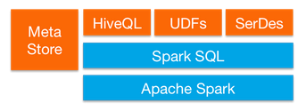
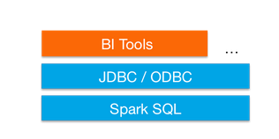
SparkSQL
Provide for relational queries expressed in SQL, HiveQL using Scala, Python, and Java API’s
Seamlessly mix SQL queries with Spark programs
Dataframes provide a single interface for efficiently working with structured data including Apache Hive, Parquet and JSON files
Graduated from alpha status with Spark 1.3
  DataFrames API marked as experimental in 2013
Standard connectivity through JDBC/ODBC
Notes:
Spark 2.0 due out in May /June 2016
IBM Big Data & Analytics © 2016 IBM Corporation

Slide 27
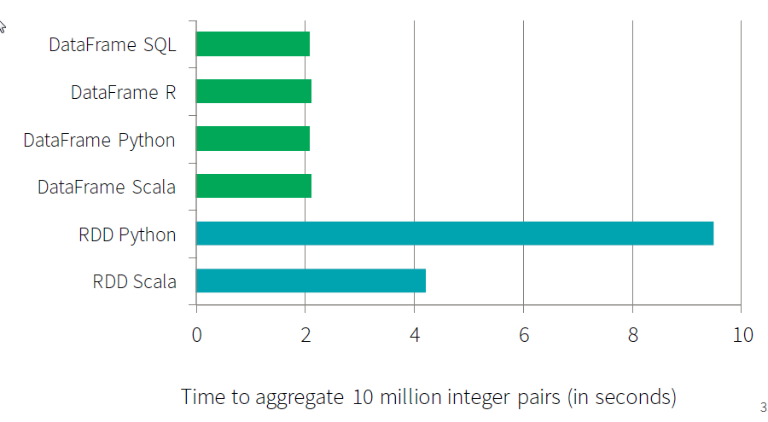
SparkSQL, DataFrames and DataSets
A rich set of functionality that allows “Database-like” processing
Share single optimizer, called “Catalyst” (at the driver)
  An open-source extensible query optimizer
Because it is the same engine, it has exactly the same performance for different APIs
  And performance is much better than for RDD
Much less code
All SparkSQL, DF, and DataSets are essentially using the same engine
Picture credit: databricks.com
Notes:
Data Sets is strongly typed so where you specify the data type such as a String, ….versus a DataFrame is strictly a schema w/o types
Mixing of sql with programmatic data manipulation
Single application combining analytics with sql
Sql is the perferred way to deal with structured and semi structured data
IBM Big Data & Analytics © 2016 IBM Corporation

Slide 28
Closer Look at APIs - Streaming
Micro-batch event processing for near-real time analytics
e.g. Internet of Things (IoT) devices,
Twitter feeds, Kafka (event hub), etc.
Spark’s engine drives some action or outputs data in batches to various
data stores
No multi-threading or parallel process programming required
Spark Streaming
Spark SQL
MLlib
Machine Learning
GraphX Graphing
+
Spark Core
Notes:
Spark Streaming, another essential component of the Spark Core libraries, enables micro-batching and near-real time event processing. This library is particularly useful when dealing with Internet of Things (IoT) devices, rapid throughput systems like social media feeds (Twitter), or event-listener technologies such as Apache Kafka or RabbitMQ. We will go into Spark Streaming in much greater detail later on in this presentation.

Slide 29


Spark Streaming
Component of Spark
  Project started in 2012
  First alpha release in Spring 2013
  Out of alpha with Spark 0.9.0
  More enhancements targeted for Spark 2.0
Discretized Stream (DStream) programming abstraction
  Represented as a sequence of RDDs (micro-batches)
  RDD: set of records for a specific time interval
  Supports Scala, Java, and Python (with limitations)
Fundamental architecture: batch processing of datasets
Notes:
Spark Streaming is an extension of the core Spark API. The project was started in 2012, released as alpha in the spring of 2013. It came out of alpha with the Spark 0.9.0 release in February 2014.
It defines a new abstraction: Discretized Streams or DStreams. DStream represents a sequence of RDDs where each RDD is a collection or records that accumulated within a specific time interval.
Just like Spark, it supports Scala, Java and, with limitations, Python.
We have to understand that Spark Streaming is a construct that depends on Spark. Spark Streaming consists of the submissions of Spark jobs at specific intervals. So in this context, as the submission rate increases, it becomes a higher percentage of the overall processing load.
IBM Big Data & Analytics © 2016 IBM Corporation

Slide 30
Closer Look at APIs – Machine Learning
Predictive and prescriptive analytics
Machine learning algorithms for:
  Clustering
  Classification
  Regression
  etc.
Smart application design from
pre-built, out-of-the-box statistical
and algorithmic models
MLlib
Machine Learning
Spark SQL
Spark Streaming
GraphX Graphing
+
Spark Core
Notes:
MLLib, or Spark’s Machine Learning library, is another key component of the Spark Core framework. It enables developers, data scientists, and statisticians to apply advanced machine learning and predictive modeling techniques within their Spark code. Complex modeling and analytical techniques like clustering, classification, regression, support vector models, and so on are templated and coded as a part of the MLLib library. This allows these audiences to get to work immediately on these complex theorems and models, without the hassle and complexity of implementing these algorithms in Spark code ahead of time.

Slide 31
Spark MLlib
Spark MLlib for machine learning library
  Marked as under active development
Provides common algorithm and utilities
  Classification
  Regression
  Clustering
  Collaborative filtering
  Dimensionality reduction
Leverages iteration and yields better results than one-pass approximations sometimes used with MapReduce
Notes:
Clustering Recommendation Engines
Machine Learning came from IBM Research
It divides into two packages: spark.mllib contains the original API built on top of RDDs. And spark.ml provides higher-level API built on top of DataFrames for constructing ML pipelines.
http://spark.apache.org/docs/latest/mllib-guide.html
Classification – decision trees , linear regression, logistics
Regression -
Clustering
Collaborative Filtering – Recommendation
IBM Big Data & Analytics © 2016 IBM Corporation

Slide 32
Closer Look at APIs – Graph DB
Represent and analyze systems represented by
graph nodes
Trace interconnections between graph nodes
Applicable to use cases in transportation, telecommunications, road networks, modeling
personal relationships, social media, etc.
GraphX Graphing
Spark SQL
Spark Streaming
MLlib
Machine Learning
+
Spark Core
Notes:
Finally, the GraphX library provides essential graphing tools as part of the Spark Core framework. Similarly to the MLLib library, the GraphX library handles the complexity of modeling graphing databases and structures ahead of time; therefore, a user of the GraphX library can immediately start leveraging graphing techniques– like tracing relationships, edges between nodes, and so on –without the complex overhead of coding these models in Spark themselves. GraphX libraries are particularly useful when dealing with use cases and workloads that extend to telecommunication projects, city planning, social media networking, and many others.

Slide 33
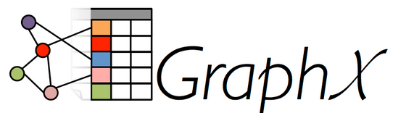
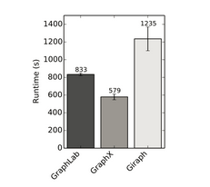
Spark GraphX
Flexible Graphing
  GraphX unifies ETL, exploratory analysis, and iterative graph computation
  You can view the same data as both graphs and collections, transform and join graphs with RDDs efficiently, and write custom iterative graph algorithms with the API
  GraphFrames - graph library based on Data Frames
Speed
  Comparable performance to the fastest specialized graph processing systems.
Algorithms
  Choose from a growing library of graph algorithms
  In addition to a highly flexible API, GraphX comes with a variety of graph algorithms
Notes:
Check release of Graph Frames
Documentation http://spark.apache.org/docs/latest/graphx-programming-guide.html
Extenstion to the rdd api and is a common graph algorithmm used for page rankingor triangulation
IBM Big Data & Analytics © 2016 IBM Corporation

